Slide 1
Presentation about Hung King Temple

Slide 2
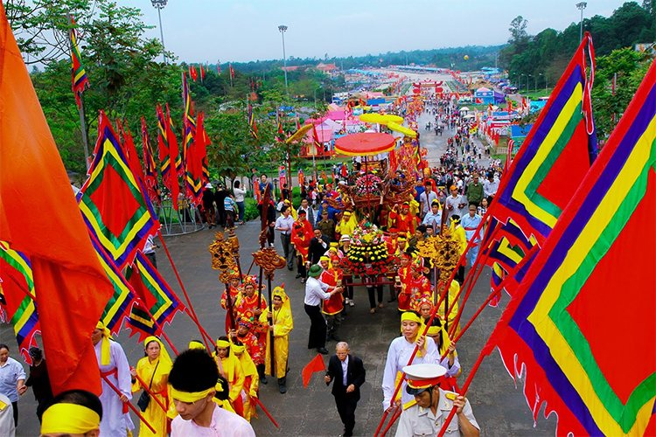
The Hùng Kings’ Festival, or Hung Kings Commemoration Day is a Vietnamese festival held annually from the 8th to the 11th day of the third lunar month in honour of Hùng Kings

Slide 3
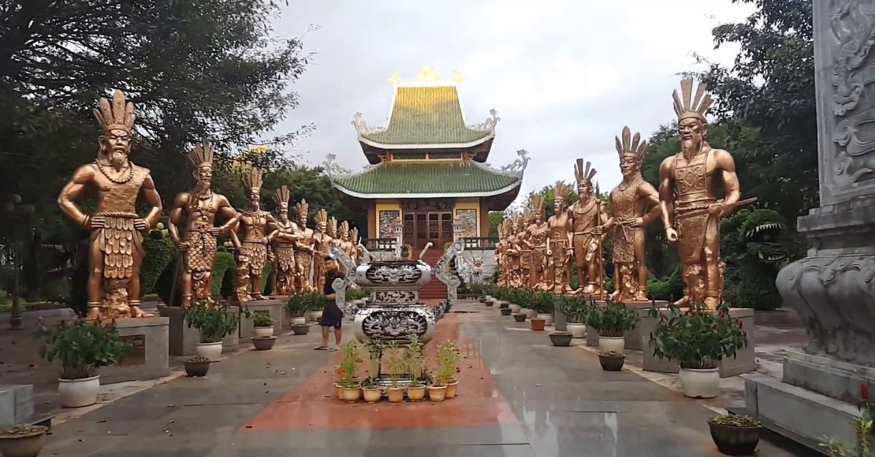
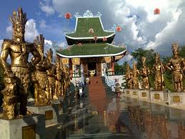
The purpose of this ceremony is to remember and pay tribute to the Hung Kings who are the traditional founders and first kings of the nation. The festival began as a local holiday, but has become recognized as a national holiday since 2007

Slide 4
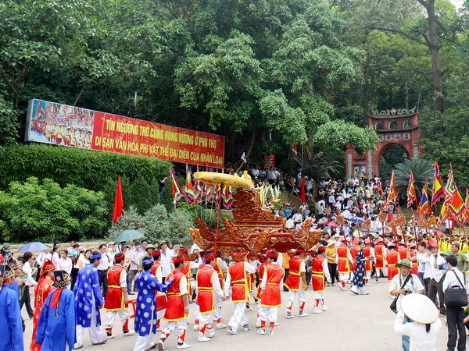
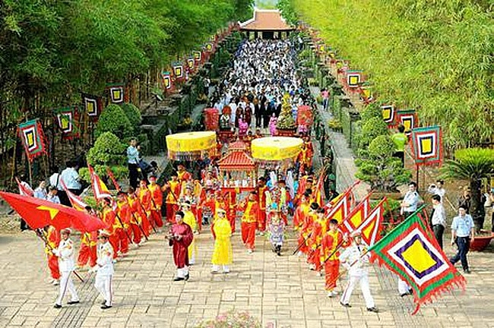
On the 10th day of the third lunar month, Vietnamese working people can have a day off to mark the anniversary of the Hung King’s death. Some will travel to the Hung King Temple in Phu Tho to participate in the festival

Slide 5
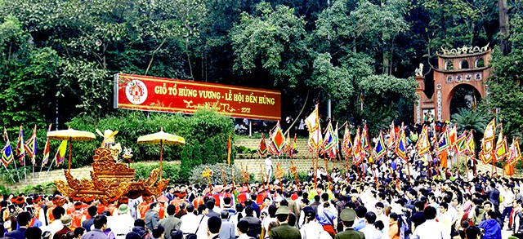
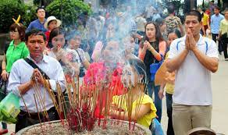
Here, pilgrims offer prayers and incense to their ancestors. However, some will stay at home and enjoy their holiday. In addition, if the festival day is close to the weekend, many families or groups of friends choose going for a short trip to recharge their battery.

Slide 6
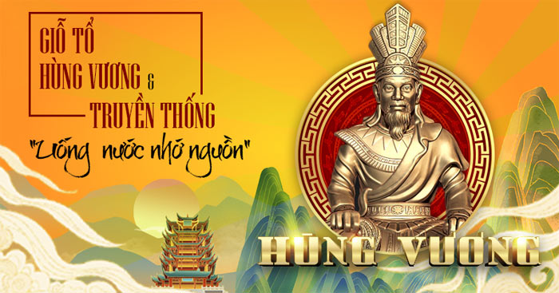
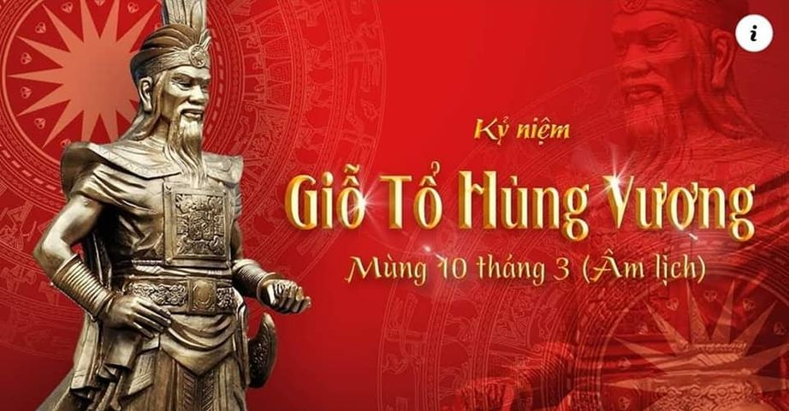
The Hung King Temple Festival is one of the most important and sacred festivals of the Vietnamese people. It is also a pilgrimage back to the origins of the Vietnamese nation.

